Slide 1
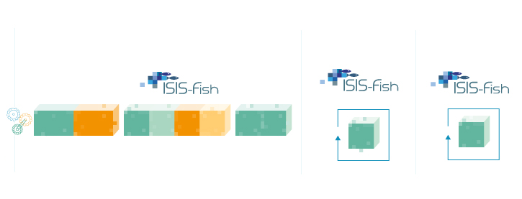

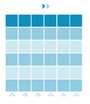

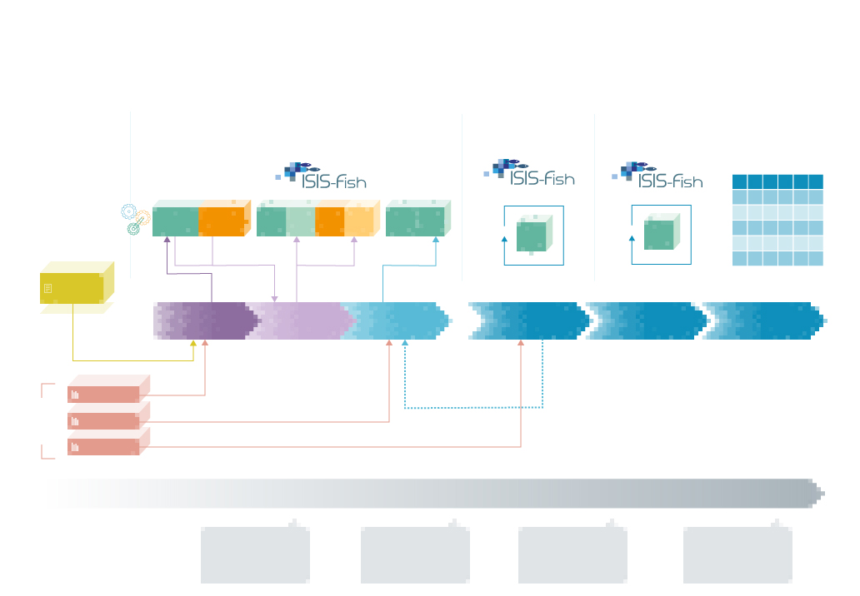
KNOWLEDGE
REVIEW
SETTING
VALIDATION
SIMULATION
^
^
?
^
^
^
^
Database
V1
Database
V1
DATABASE V0
SCENARIO
LITERATURE
UPDATE & ESTIMATION
CALIBRATION
texte descriptif
MODEL SKILL ASSESSMENT
SIMULATION
ANALYSE
D’INCERTITUDE
MODEL OUTPUTS
LANGOLF
SACROIS
InterCatch
ESTIMATES DATA
Other 1
Other 2
2010
2013
TAL for 3 species
2016
TAC & LO : sole & hake
TAL : Norway lobster
2020
FUTURE

